Slide 1


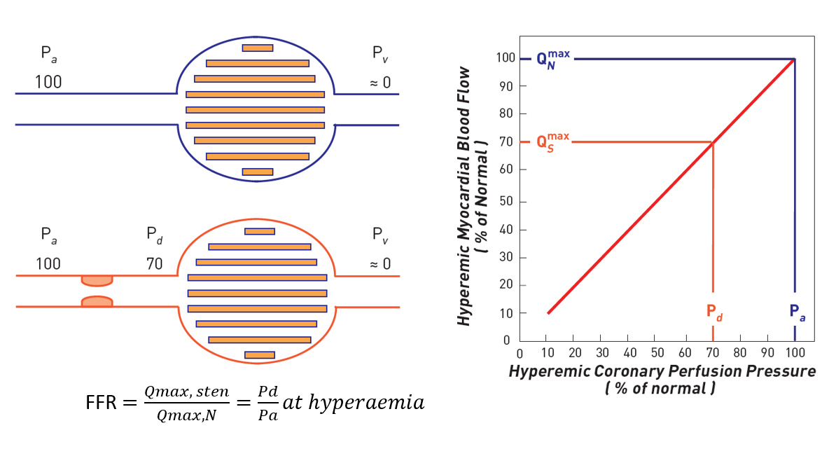

Invasive physiological assessment of coronary disease (FFR)
Figure 3
Concept of fractional flow reserve (FFR) measurements. When no epicardial stenosis is present (blue lines) the driving pressure Pa determines a normal (100%) maximal myocardial blood flow. In case of stenosis responsible for a hyperaemic pressure gradient of 30 mmHg (red lines), the driving pressure will no longer be 100 mm Hg but 70 mm Hg (Pd). Since during maximal hyperaemia the relationship between driving pressure and myocardial blood flow is linear, myocardial blood flow will only reach 70% of its normal value. This numerical example shows how a ratio of two pressure (Pd/Pa ) corresponds to a ratio of two flows (QSmax / QNmax). It also illustrates how important it is to induce maximal hyperaemia.
Pim A.L. Tonino, Nico H.J. Pijls, Danielle C.J. Keulards
©2025 Europa Group - All rights reserved.

