Slide 1


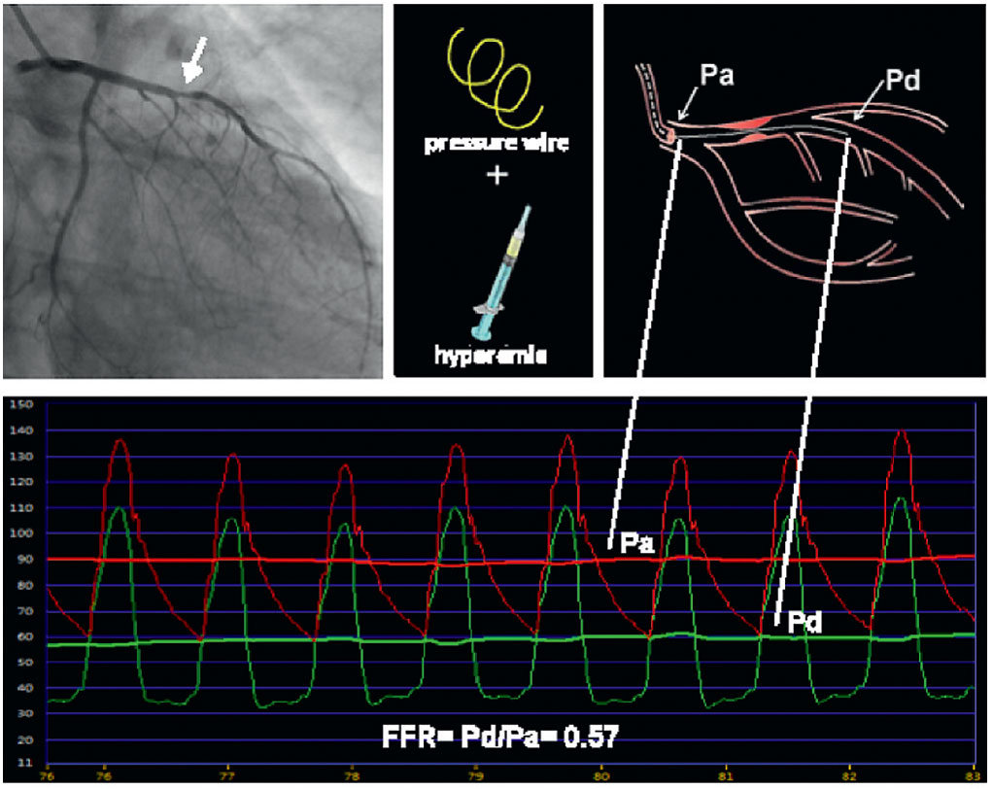

Invasive physiological assessment of coronary disease (FFR)
Figure 4
Example of FFR with an ambiguous stenosis causing significant ischaemia. During maximum coronary hyperemia, myocardial blood flow is proportional to coronary perfusion pressure. With a pressure sensor-tipped guidewire and an adequate hyperaemic stimulus, FFR can be calculated as the ratio Pd/Pa. The lower part of this figure shows pressure tracings as displayed on an analyser, derived from a sensor-tipped wire, with the sensor placed distal from the stenosis (Pd, green signal) in the left anterior descending (LAD) artery, and from the tip of the guiding catheter (Pa, red signal). Despite the fact that the narrowing (arrow) does not look very severe on the coronary angiogram, its physiological or haemodynamic impact is important as reflected by the low value of FFR of 0.57, indicating that as a result of this stenosis, maximum blood flow to the anterior wall in this patient has decreased to 57% of its normal value, without stenosis.
Pim A.L. Tonino, Nico H.J. Pijls, Danielle C.J. Keulards
©2025 Europa Group - All rights reserved.

