Slide 1


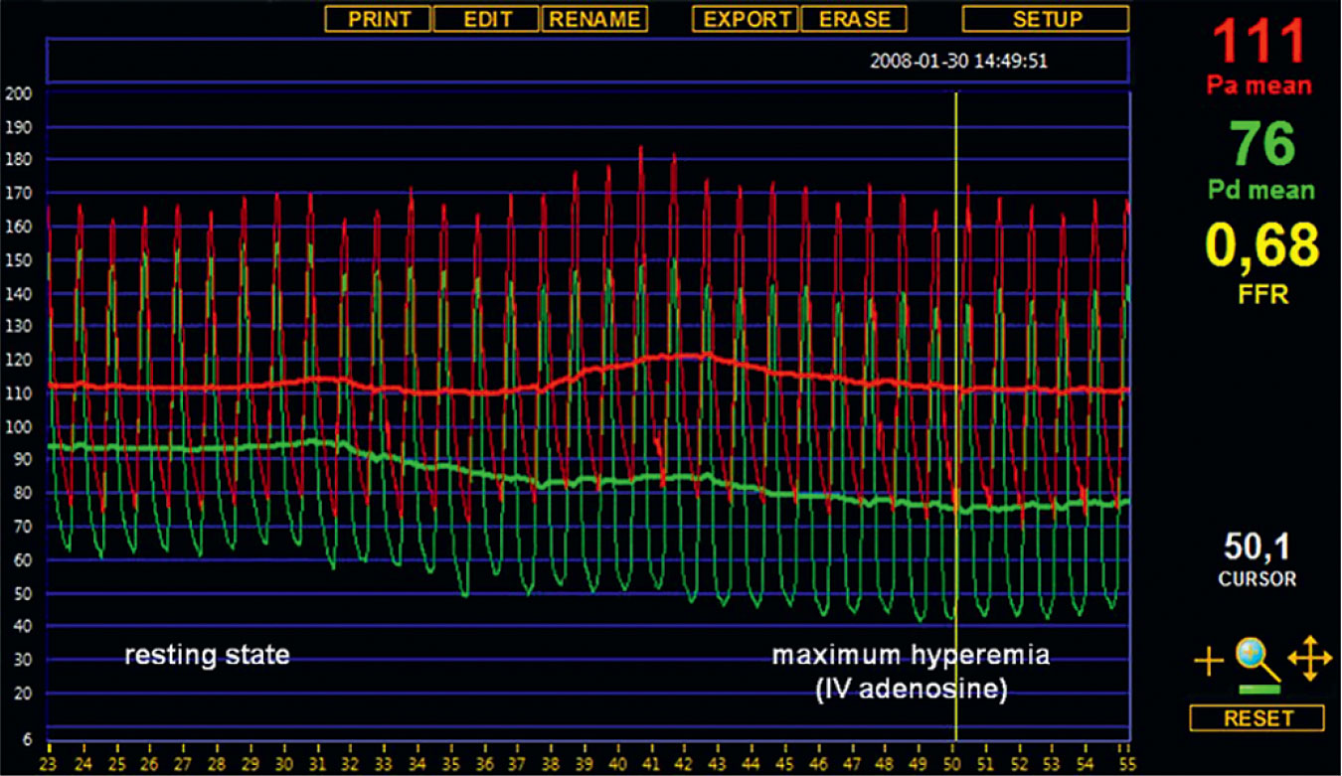

Invasive physiological assessment of coronary disease (FFR)
Figure 5
An accurate FFR measurement requires minimalization of microvascular resistance. Typical example of simultaneous aortic pressure (Pa) and distal coronary pressure (Pd) recordings at rest and during maximal steadystate hyperaemia as induced by an intravenous infusion of adenosine. Fractional flow reserve is simply calculated as the ratio between mean distal coronary pressure and mean aortic pressure during steady state maximum hyperaemia.
Pim A.L. Tonino, Nico H.J. Pijls, Danielle C.J. Keulards
©2025 Europa Group - All rights reserved.

