Slide 1


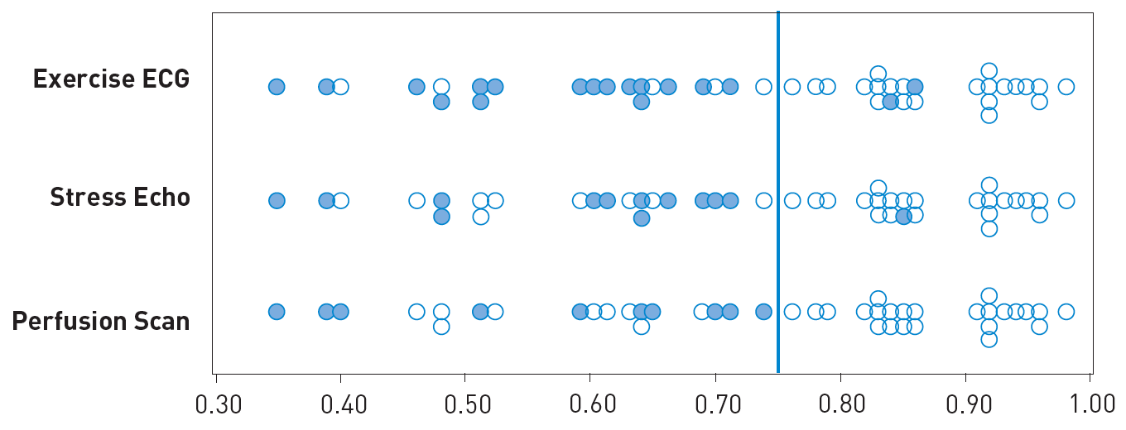

Invasive physiological assessment of coronary disease (FFR)
Figure 6
Relation between FFR and angiographically intermediate stenosis. Plots of the FFR in 45 patients with an angiographically intermediate stenosis according to the results of non-invasive testing. The circles represent negative tests. The dots represent positive tests. Tests were considered true positive only if they were positive before revascularisation and reversed to negative after succesfull revascularisation. FFR was considered positive if at least one test was unequivocally true positive before intervention and returned to negative thereafter. FFR was considered negative if all 3 tests could be exhaustively performed within 24 hours without ischemia (reference 35).
Pim A.L. Tonino, Nico H.J. Pijls, Danielle C.J. Keulards
©2025 Europa Group - All rights reserved.

