Slide 1


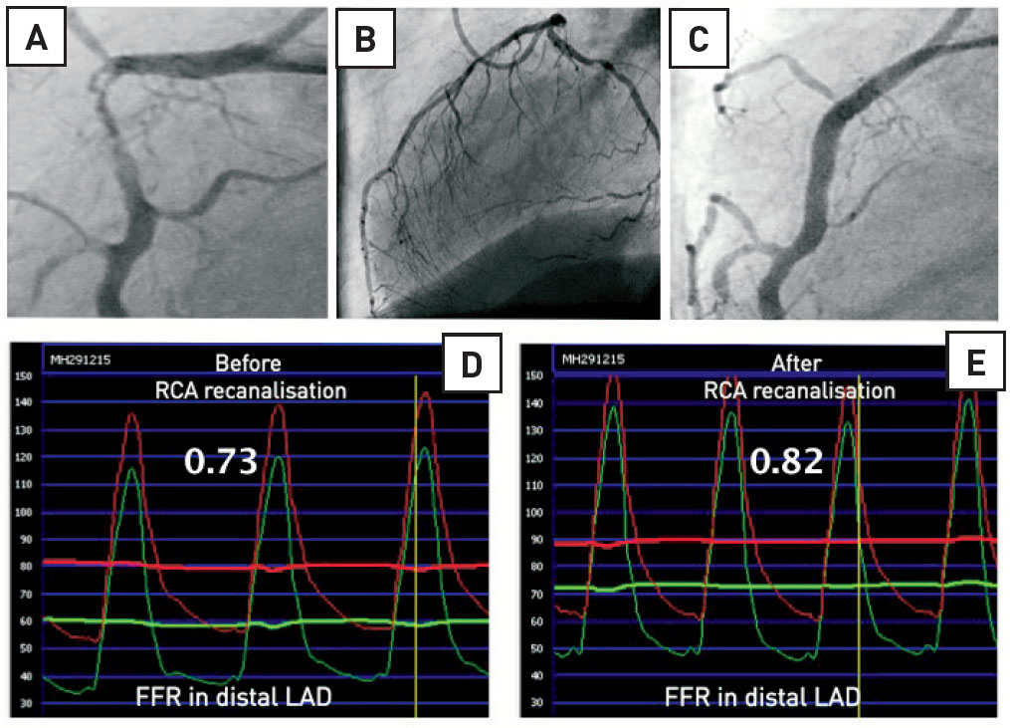

Invasive physiological assessment of coronary disease (FFR)
Figure 7
Influence of collaterals on FFR. Example of the influence of collaterals on FFR measurements in a 76-year-old man with a critical stenosis in the proximal RCA (panel A) and collaterals supplied by the left coronary artery (panel B). The FFR in the distal LAD was measured first before recanalization of the RCA (panel D) and after recanalisation of the RCA (panel C and E). When antegrade flow was restored in the RCA, the LAD had no longer to supply blood to the territory of the RCA. Therefore, hyperaemic flow in the LAD was lower than before and the FFR increased from 0.73 to 0.82. This example also illustrates the relationship between FFR and the myocardial mass supplied by the artery: the larger the myocardial mass, the larger hyperaemic flow, the lower the FFR for a given stenosis.
Pim A.L. Tonino, Nico H.J. Pijls, Danielle C.J. Keulards
©2025 Europa Group - All rights reserved.

