Slide 1


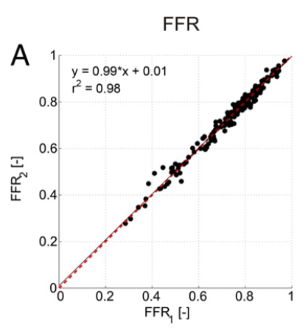

Invasive physiological assessment of coronary disease (FFR)
Figure 8
Reproducibility of FFR Scatterplot showing reproducibility of FFR. Line of identity is in red (dashed). Linear regression equation line is shown in solid black.
Pim A.L. Tonino, Nico H.J. Pijls, Danielle C.J. Keulards
©2025 Europa Group - All rights reserved.

