Slide 1


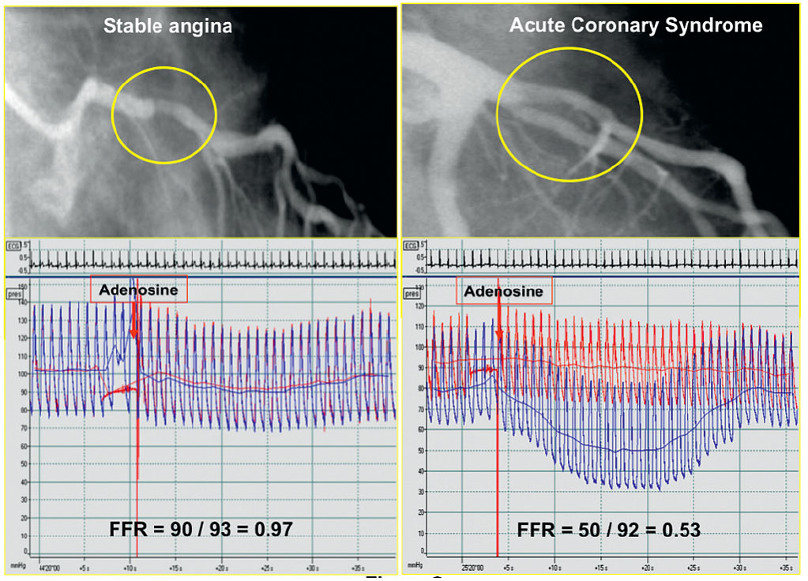

Invasive physiological assessment of coronary disease (FFR)
Figure 9
Example of two patients in whom an angiographically similar stenosis is found in the proximal left anterior descending coronary artery. In the left example the lesion has no haemodynamic significance and does not need any form of mechanical revascularisation. In the right example the stenosis is haemodynamically very significant and deserves PCI.
Pim A.L. Tonino, Nico H.J. Pijls, Danielle C.J. Keulards
©2025 Europa Group - All rights reserved.

