Slide 1


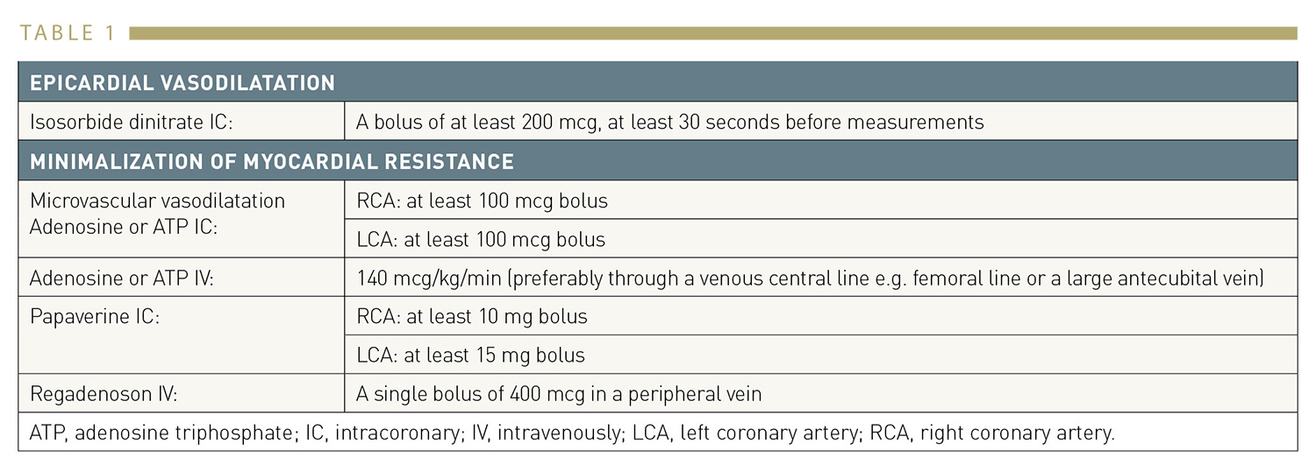

Invasive physiological assessment of coronary disease (FFR)
Table 1
Pharmacological agents for the induction of vasodilation/hyperaemia
Pim A.L. Tonino, Nico H.J. Pijls, Danielle C.J. Keulards
©2025 Europa Group - All rights reserved.

