Slide 1


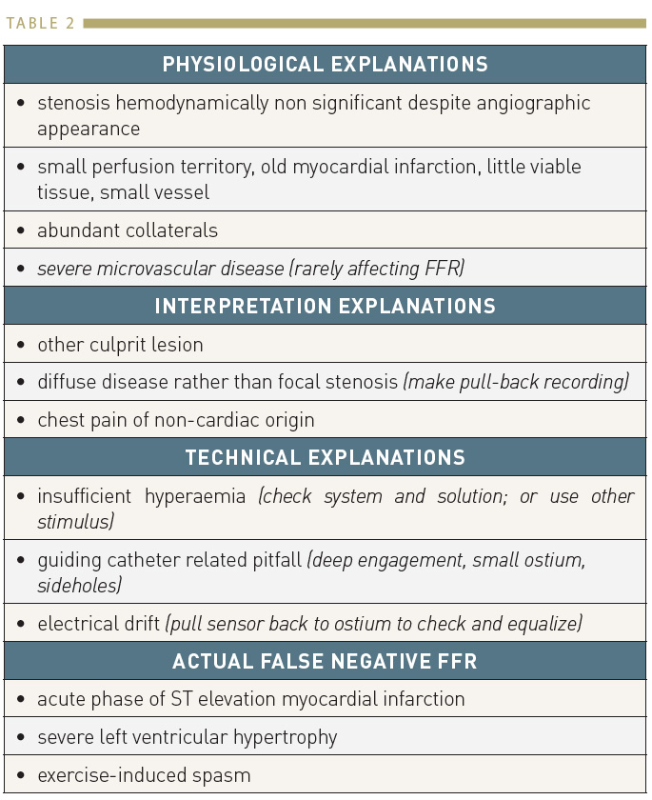

Invasive physiological assessment of coronary disease (FFR)
Table 2
Reasons of non-ischaemic FFR despite an apparently tight stenosis
Pim A.L. Tonino, Nico H.J. Pijls, Danielle C.J. Keulards
©2025 Europa Group - All rights reserved.

