Slide 1


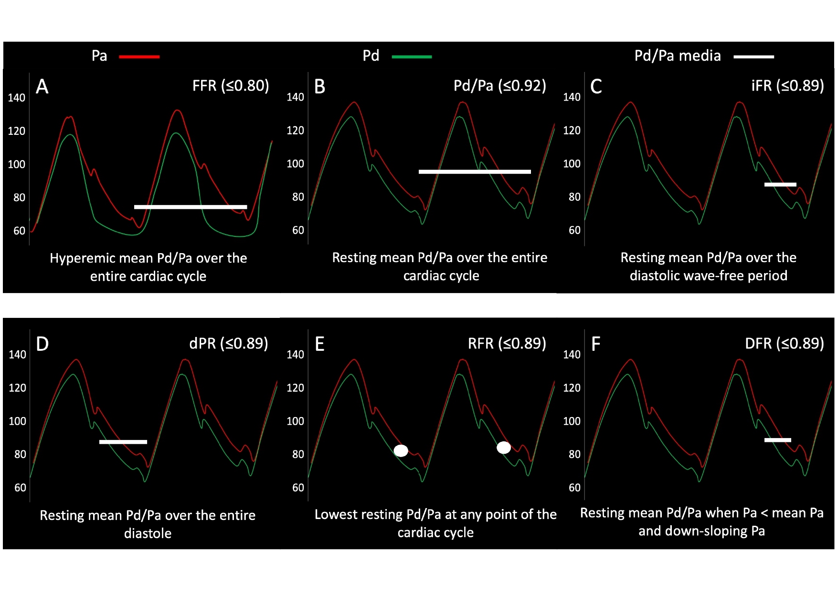

Invasive physiological assessment of coronary
disease: non-hyperaemic indices (iFR) (old)
Figure 11
Figure representing the period of the cardiac cycle during which each measurement is taken. (A): FFR is a hyperaemic index calculated over the entire cardiac cycle. (B): resting Pd/Pa is calculated over the entire cardiac cycle. (C): iFR is calculated over the diastolic wave free period. (D): dPR is calculated over the entire diastolic period. (E): RFR is the lowest Pd/Pa calculated at any point of the cardiac cycle. (F): DFR is calculated when Pa is less than the mean Pa and Pa is downsloping.
Nieves Gonzalo, Hernan Mejia-Renteria, Angela McInerney, Javier Escaned
©2025 Europa Group - All rights reserved.

