Slide 1


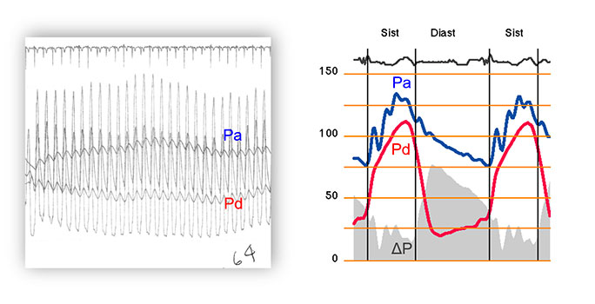

Invasive physiological assessment of coronary disease: non-hyperaemic indices (iFR) (old)
Figure 2
Average versus instantaneous pressure gradient in pressure-guidewire interrogation. The left panel in the figure shows how FFR was measured before the availability of dedicated FFR consoles. Averaged pressure measurements, obtained over several cardiac cycles, were used. This approach was subsequently continued with the arrival of dedicated FFR consoles. The right panel shows how, on the contrary, translesional pressure gradient varies instantaneously over the cardiac cycle, mirroring the waveform of phasic coronary flow. As a result of this, during diastole instantaneous pressure gradient has a much larger magnitude than that derived from the FFR-based technology described in left panel.
Nieves Gonzalo, Hernan Mejia-Renteria, Angela McInerney, Javier Escaned
©2025 Europa Group - All rights reserved.

