Slide 1


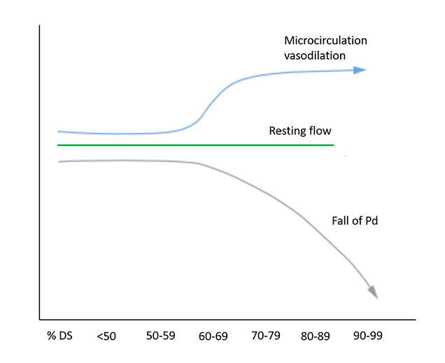

Invasive physiological assessment of coronary disease: non-hyperaemic indices (iFR) (old)
Figure 4
Non-hyperaemic coronary physiology in the context of increasing stenosis severity. The physiological impact of a coronary stenosis on the distal coronary bed can be quantified by a falling distal coronary pressure (Pd) in the resting state. %DS (% diameter stenosis). Modified from Nijjer et al (2).
Nieves Gonzalo, Hernan Mejia-Renteria, Angela McInerney, Javier Escaned
©2025 Europa Group - All rights reserved.

