Slide 1


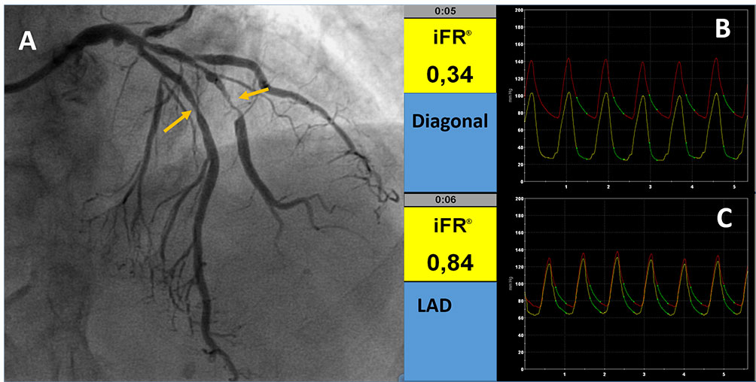

Invasive physiological assessment of coronary disease: non-hyperaemic indices (iFR) (old)
Figure 5
Examples of iFR evaluation. A: Angiographic image showing stenoses in LAD and diagonal (yellow arrows) iFR in the diagonal branch (B) and LAD (C) indicating the functional impact of the 2 stenoses. The green line in B and C indicates the wave free period in which the index is calculated.
Nieves Gonzalo, Hernan Mejia-Renteria, Angela McInerney, Javier Escaned
©2025 Europa Group - All rights reserved.

