Slide 1


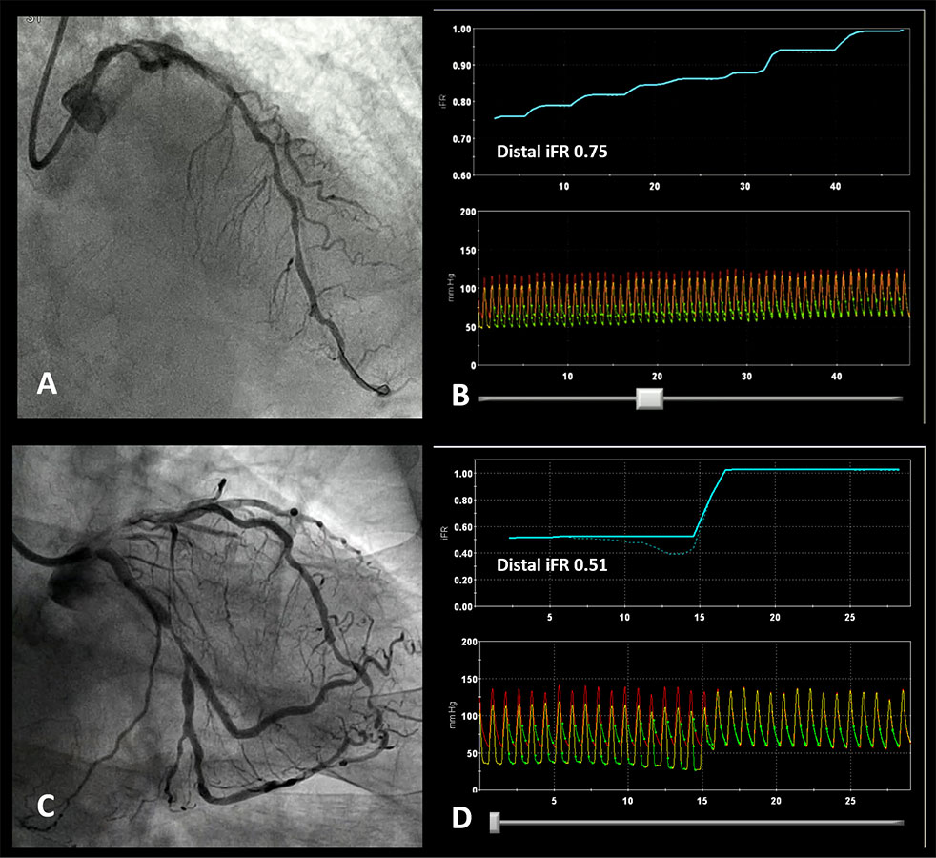

Invasive physiological assessment of coronary disease: non-hyperaemic indices (iFR) (old)
Figure 7
Patterns of disease based on iFR pullback. A. Diffusely diseased LAD with several stenoses in its mid and proximal segment. B iFR pullback trace confirming diffuse disease with a gradual increase in iFR as the pressure sensor is pulled back to the catheter without a focal ‘step up’ in pressures. C. Angiogram showing a focal LCX stenosis. D. iFR pullback demonstrated a physiologically positive result (0.51) with a focal pattern (all the pressure drop was located at the level of the mid-LCX stenosis).
Nieves Gonzalo, Hernan Mejia-Renteria, Angela McInerney, Javier Escaned
©2025 Europa Group - All rights reserved.

