Slide 1


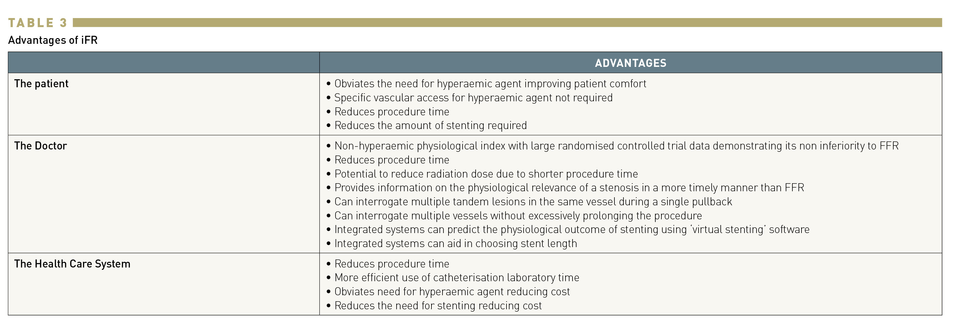

Invasive physiological assessment of coronary
disease: non-hyperaemic indices (iFR) (old)
Table 3
Nieves Gonzalo, Hernan Mejia-Renteria, Angela McInerney, Javier Escaned
©2025 Europa Group - All rights reserved.

