Slide 1


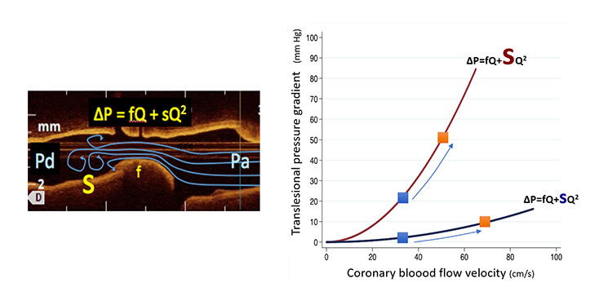

Invasive physiological assessment of coronary disease: non-hyperaemic indices (iFR)
Figure 1
Relationship between trans-stenotic pressure gradient and coronary flow. The non-lineal character of the equation relating trans-stenotic pressure gradient (DeltaP) is a result of the interaction between friction (f) and separation or turbulent (s) components of the haemodynamic effect of the stenosis and coronary flow. The figure depicts the curves of a mild and a severe coronary stenosis (the size of the letter “s” denotes the turbulence-generating ability of the coronary stenosis). Blue squares denote flow in non-hyperaemic conditions, while orange squares indicate measurements during maximal hyperaemia. In other words, the modification of resting translesional pressure gradient by adenosine is a result of an increase in coronary flow occurring during hyperaemia.
Nieves Gonzalo, Hernan Mejia-Renteria, Angela McInerney, Luca Paolucci, Javier Escaned
©2025 Europa Group - All rights reserved.

