Slide 1


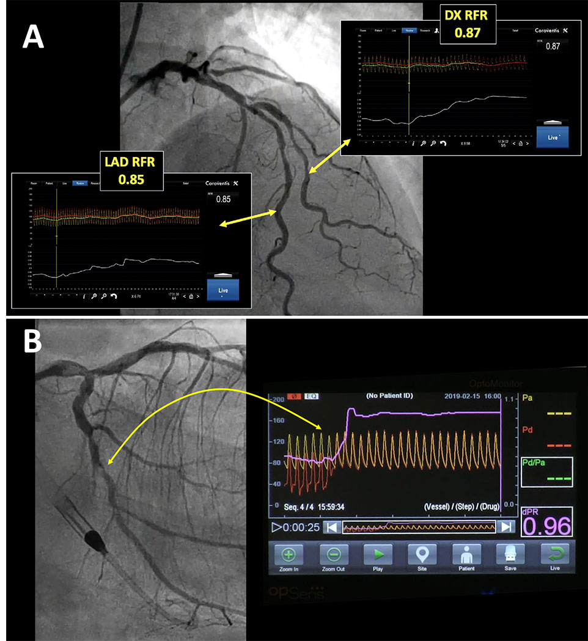

Invasive physiological assessment of coronary disease: non-hyperaemic indices (iFR)
Figure 10
Other NHPI. A: Longitudinal vessel mapping performed with resting whole cycle Pd/Pa (RFR) in the left anterior descending (LAD) and diagonal (DX) branches, allowing identification of the segments that account for haemodynamic impairment in both vessels. (Coroventis™, Abbot, US) B: Longitudinal vessel mapping performed with diastolic pressure ratio (dPR) in the left circumflex branch after left main stenting, allowing identification of a focal stenosis that accounts for haemodynamic impairment in that vessel. (dPR, OPSENS Inc)
Nieves Gonzalo, Hernan Mejia-Renteria, Angela McInerney, Luca Paolucci, Javier Escaned
©2025 Europa Group - All rights reserved.

