Slide 1


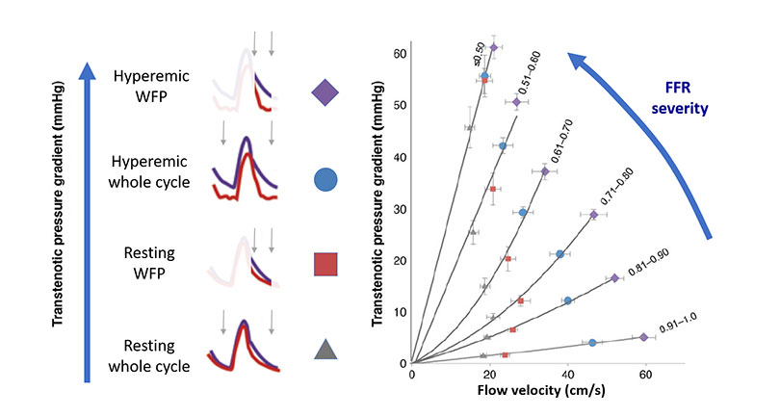

Invasive physiological assessment of coronary
disease: non-hyperaemic indices (iFR)
Figure 3
Translesional gradient modality with different sampling methodologies. Based on all discussed in Figures 1 and 2, the diagnostic efficiency of a pressure-based intracoronary index can be improved by either increasing flow with vasodilators or using specific sampling windows within the cardiac cycle. The graphic shows a family of curves depicting increasing functional stenosis severity and the location within each curve of measurements obtained with Pd/Pa, iFR, FFR or hyperaemic WFP measurements (i.e. measurements within the WFP during maximal hyperaemia). The data obtained to generate the figures was derived from the large European IDEAL registry, based on pressure and flow velocity interrogation of coronary stenoses in stable patients[2].
Nieves Gonzalo, Hernan Mejia-Renteria, Angela McInerney, Luca Paolucci, Javier Escaned
©2025 Europa Group - All rights reserved.

