Slide 1


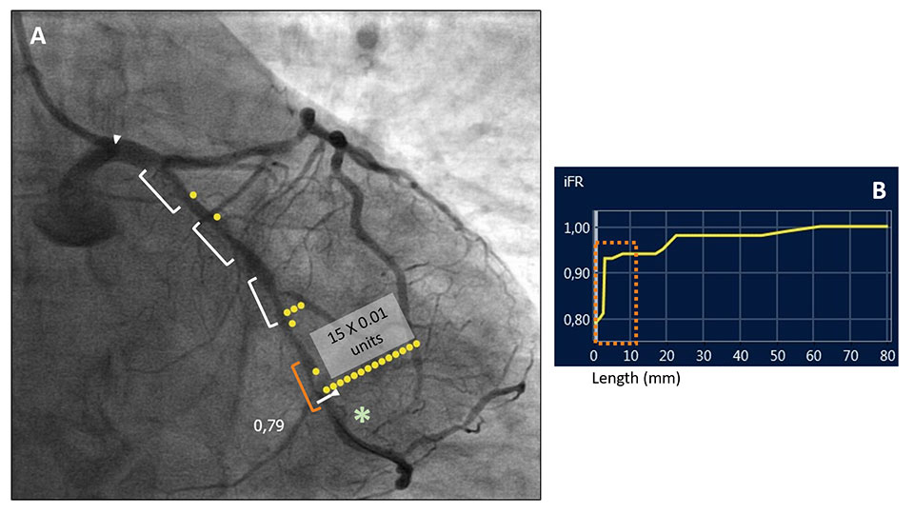

Invasive physiological assessment of coronary
disease: non-hyperaemic indices (iFR)
Figure 8
Online co-registration of iFR pullback and angiogram IFR physiological assessment of a left circumflex coronary artery with several tandem intermediate coronary stenoses (white markers) (A). The pressure-wire sensor was placed distally (*) obtaining an iFR value of 0.79, indicating physiologically significant disease. In order to determine the functional relevance of each stenosis, an iFR pullback with angiography co-registration was performed (B). The physiological map (A) allowed the identification of the more distal stenosis (orange marker in pictures A and B) as the most functionally relevant, with an iFR pressure-drop of 0.15 units. On the contrary, the other proximal three coronary stenoses did not contribute significantly to the pressure drop. (SyncVision System,Philips BV, The Netherlands).
Nieves Gonzalo, Hernan Mejia-Renteria, Angela McInerney, Luca Paolucci, Javier Escaned
©2025 Europa Group - All rights reserved.

