Slide 1


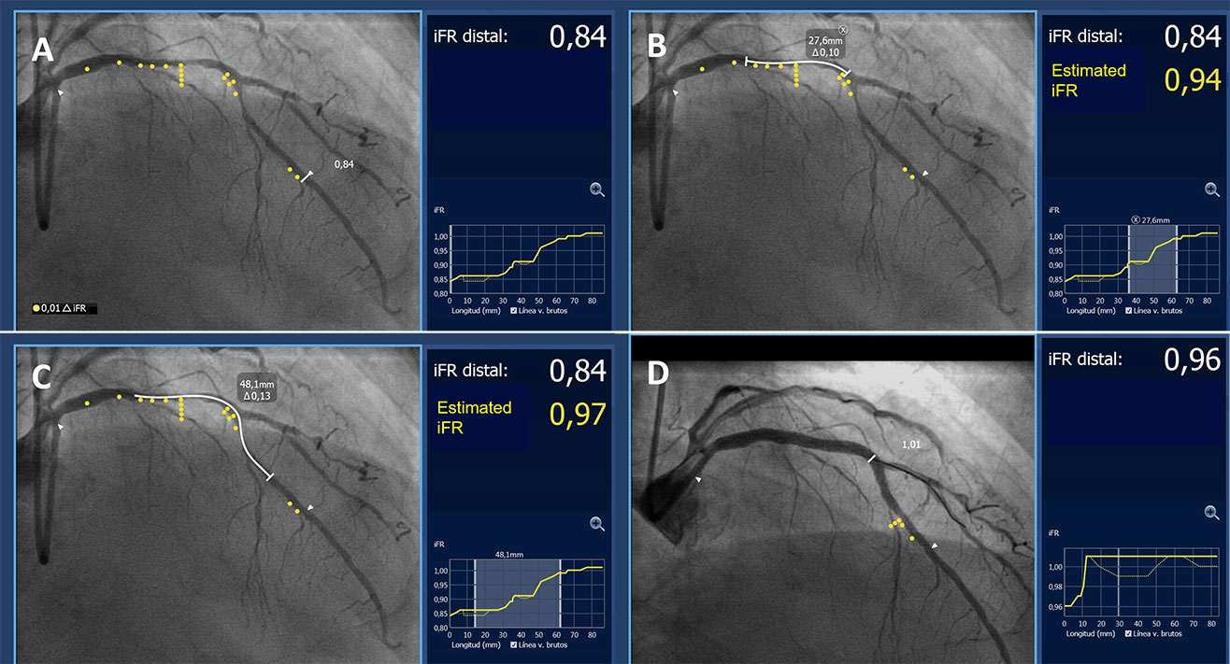

Invasive physiological assessment of coronary disease: non-hyperaemic indices (iFR)
Figure 9
Procedural guidance based on iFR pullback and angiography co-registration. A. iFR pullback and angiography co-registration demonstrating functionally significant disease (iFR 0.84) in a long segment of the LAD with 2 major areas of pressure-drop located in the proximal LAD and in the area around the first diagonal. B and C show different stenting options (white line, stent length required indicated in the box) and the estimated iFR result. D. Based on these findings the lesion was treated with 2 overlapping stents covering both areas of pressure drop. The final iFR result after PCI (0.96) demonstrated a good functional result that correlated well with the estimated iFR. (SyncVision System,Philips BV, The Netherlands).
Nieves Gonzalo, Hernan Mejia-Renteria, Angela McInerney, Luca Paolucci, Javier Escaned
©2025 Europa Group - All rights reserved.

