Slide 1


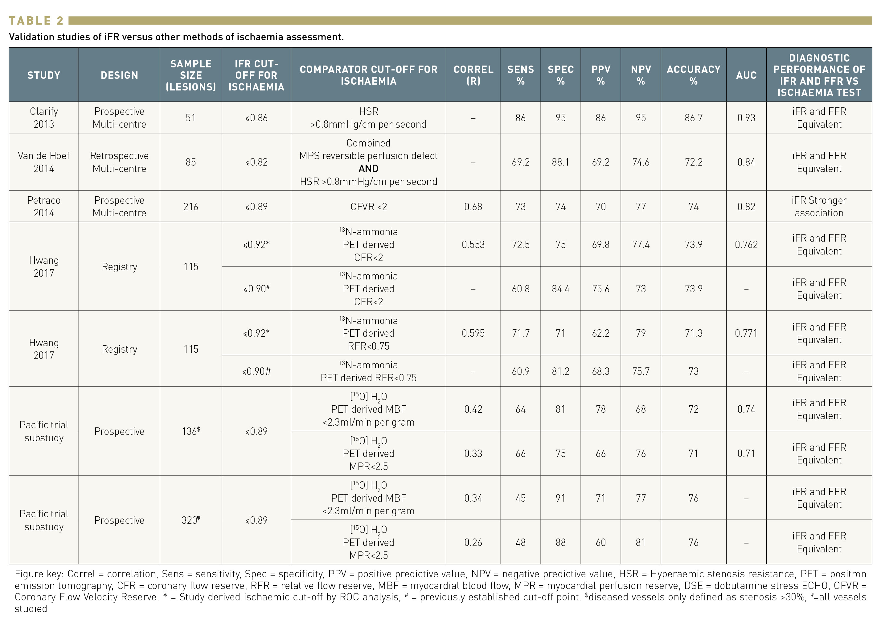

Invasive physiological assessment of coronary disease: non-hyperaemic indices (iFR)
Table 2
Nieves Gonzalo, Hernan Mejia-Renteria, Angela McInerney, Luca Paolucci, Javier Escaned
©2025 Europa Group - All rights reserved.

