Slide 1


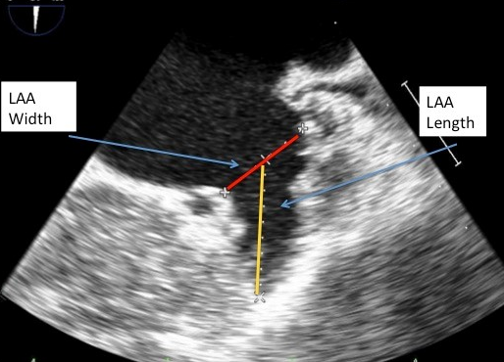

Left atrial appendage occlusion
Figure 4
Echocardiographic measurements of the LAA length and width.Echocardiographic measurements of LAA length (yellow) and width (red) taken in 45 degree view of the LAA.
Jessica V. Kaczmarek, Daniel H. Steinberg, Nicholas S. Amoroso, Stefan Bertog, Jennifer Franke, Iris Grunwald, Horst Sievert
©2025 Europa Group - All rights reserved.

