Slide 1


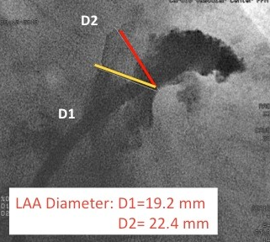

Left atrial appendage occlusion
Figure 5
Angiographic measurments of the LAA.Angiographic measurements (RAO caudal) of the LAA.
Jessica V. Kaczmarek, Daniel H. Steinberg, Nicholas S. Amoroso, Stefan Bertog, Jennifer Franke, Iris Grunwald, Horst Sievert
©2025 Europa Group - All rights reserved.

