Slide 1


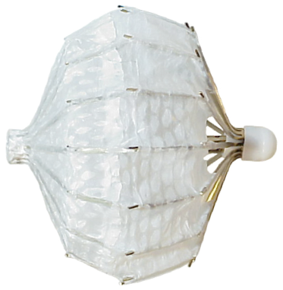

Left atrial appendage occlusion
Figure 6
PLAATO device (EV3, Plymouth, MA, USA)
Jessica V. Kaczmarek, Daniel H. Steinberg, Nicholas S. Amoroso, Stefan Bertog, Jennifer Franke, Iris Grunwald, Horst Sievert
©2025 Europa Group - All rights reserved.

