Slide 1


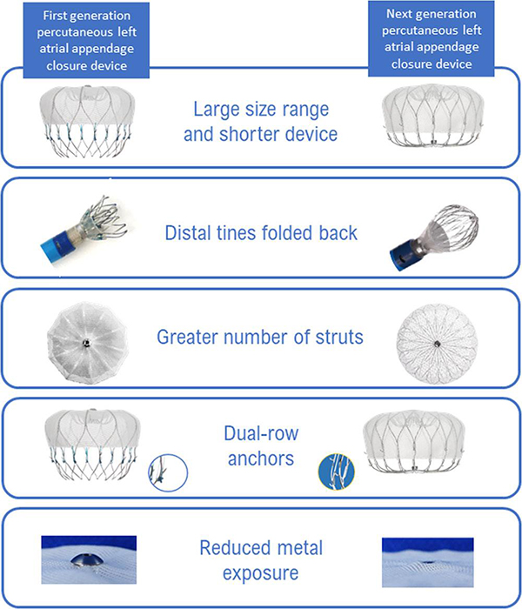

Left atrial appendage occlusion
Figure 7
Watchman versus Watchman FLX devices. Watchman FLX (Boston Scientific, Minneapolis, MN, USA) Reprinted with permission from Kar S, Doshi S, Sadhu D, et al. Primary Outcome Evaluation of a Next-Generation Left Atrial Appendage Closure Device. Circulation. 2021;143:1754–1762. DOI:10.1161/CIRCULATIONAHA.120.050117
Jessica V. Kaczmarek, Daniel H. Steinberg, Nicholas S. Amoroso, Stefan Bertog, Jennifer Franke, Iris Grunwald, Horst Sievert
©2025 Europa Group - All rights reserved.

