Slide 1


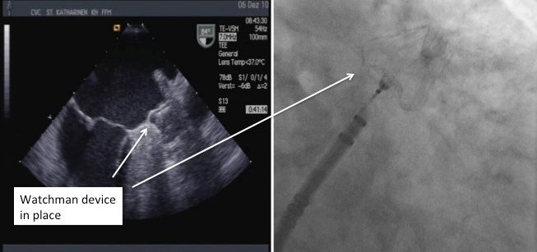

Left atrial appendage occlusion
Figure 8
Fluoroscopic and Echocardiographic view of deployed Watchman device.
Jessica V. Kaczmarek, Daniel H. Steinberg, Nicholas S. Amoroso, Stefan Bertog, Jennifer Franke, Iris Grunwald, Horst Sievert
©2025 Europa Group - All rights reserved.

