Slide 1


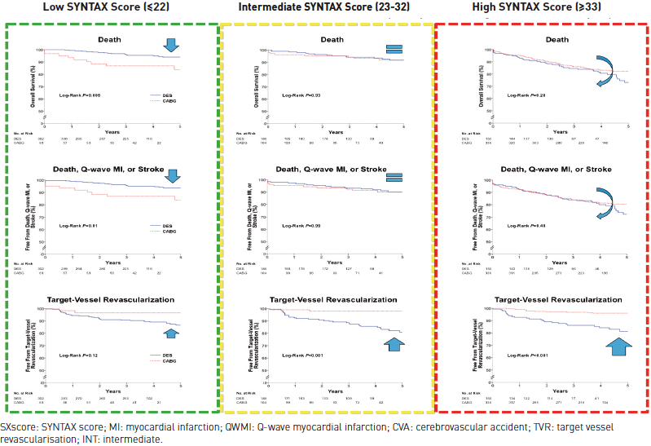

Left main coronary artery disease (old)
Figure 13
Long term (5 year) survival according to SYNTAX tertiles in left mainAdjusted survival curves for the long-term (5-year) outcomes according to low (green), intermediate (yellow) and high (red) SXscore groups, for the outcomes of death (upper), death/QWMI/CVA (middle), and TVR (lower) from the MAIN-COMPARE registry (n=1, 146). Note the numerically lower incidence of death and death/QWMI/CVA with PCI at a low SXscore, which becomes equivalent at an intermediate SXscore and reverses at a high SXscore. Conversely, note the progressive increase in the incidence of TVR with a higher SXscore. Original image kindly provided by SJ Park and colleagues, Asan Medical Center, Seoul, South Korea. Adapted and reproduced with permission from Park et al [7].
Rodrigo Modolo, Norihiro Kogame, Hidenori Komiyama, Vasim Farooq, Gregg
W. Stone, Renu Virmani, Patrick W. Serruys, Alfonso Fernando
©2025 Europa Group - All rights reserved.

