Slide 1


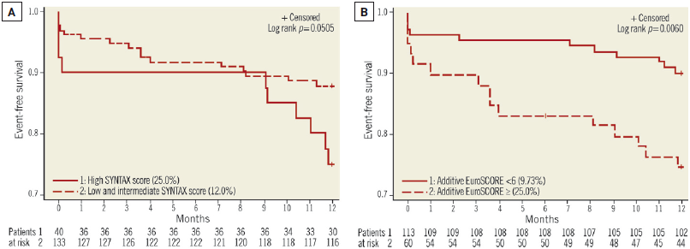

Left main coronary artery disease (old)
Figure 14
LEMAX Pilot StudyThe LEMAX Pilot Study investigating unprotected left main stenting with the second-generation Xience Prime DES (n=173). Kaplan-Meier curves for freedom from MACCE in patients with a high SXscore (A) and high EuroSCORE (≥6) (B) are illustrated. Note the association with adverse clinical outcomes after ULM PCI. Reproduced with permission from Salvatella et al [235].
Rodrigo Modolo, Norihiro Kogame, Hidenori Komiyama, Vasim Farooq, Gregg W. Stone, Renu Virmani, Patrick W. Serruys, Alfonso Fernando
©2025 Europa Group - All rights reserved.

