Slide 1


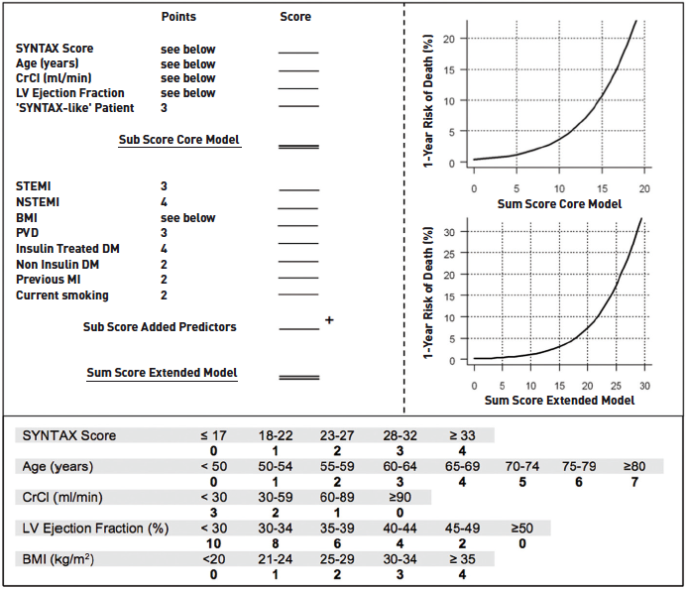

Left main coronary artery disease (old)
Figure 17
The Logistic Clinical SYNTAX score for the prediction of 1-year death * 'SYNTAX-like' patient defined as fulfilling the enrolment criteria for the SYNTAX All-Comers trial, i.e., left main stem (isolated or associated with one, two or three vessel disease) or three vessel disease alone.CrCl: creatinine clearance; STEMI: ST-elevation myocardial infarction; BMI: body mass index; LV Ejection Fraction: left ventricular ejection fraction; PVD: peripheral vascular disease; DM: diabetes mellitus; MI: myocardial infarction. Reproduced from Farooq et al [106].
Rodrigo Modolo, Norihiro Kogame, Hidenori Komiyama, Vasim Farooq, Gregg W. Stone, Renu Virmani, Patrick W. Serruys, Alfonso Fernando
©2025 Europa Group - All rights reserved.

