Slide 1


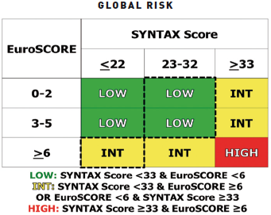

Left main coronary artery disease (old)
Figure 18
Global RiskThe Global Risk demonstrating recategorisation of established tertiles of risk for the SXscore and additive EuroSCORE (9 risk groups) to form low (GRC low), intermediate (GRC int) and high (GRC high) Global Risk groups. Highlighted (dashed) boxes indicate patients moved into or out of the low SXscore group to form a low risk (GRC Low) and intermediate risk (GRC int) group. Adapted from Capodanno et al [93, 94]. Reproduced with permission from Serruys et al [5, 6].
Rodrigo Modolo, Norihiro Kogame, Hidenori Komiyama, Vasim Farooq, Gregg W. Stone, Renu Virmani, Patrick W. Serruys, Alfonso Fernando
©2025 Europa Group - All rights reserved.

