Slide 1


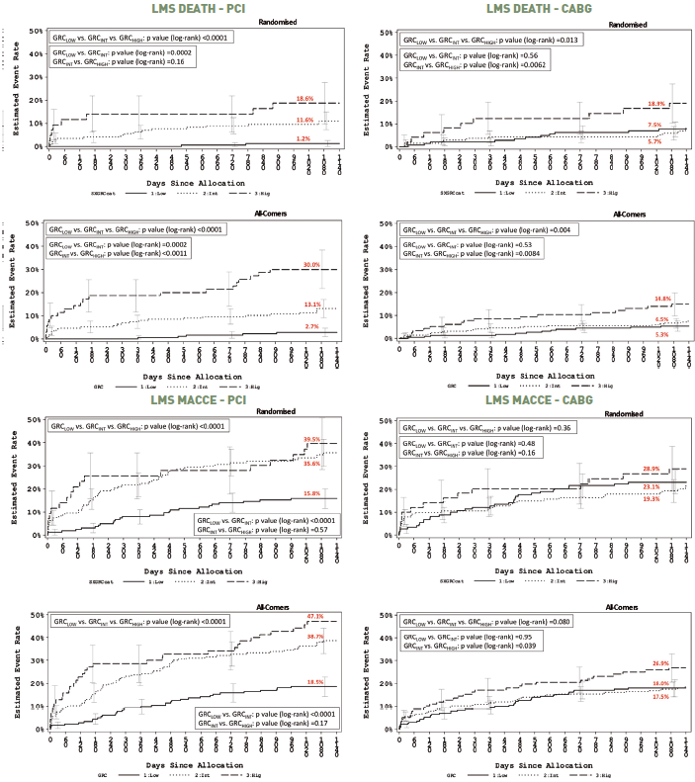

Left main coronary artery disease (old)
Figure 20
Comparisons of clinical outcomes by categories of global risk in the SYNTAX LMS populationKaplan-Meier curves for cumulative rate of death (upper) and MACCE (lower) at 3-year follow-up stratified according to the Global Risk group, event rate ±1.5 SE. Reproduced with permission from Serruys et al [5, 6].
Rodrigo Modolo, Norihiro Kogame, Hidenori Komiyama, Vasim Farooq, Gregg W. Stone, Renu Virmani, Patrick W. Serruys, Alfonso Fernando
©2025 Europa Group - All rights reserved.

