Slide 1


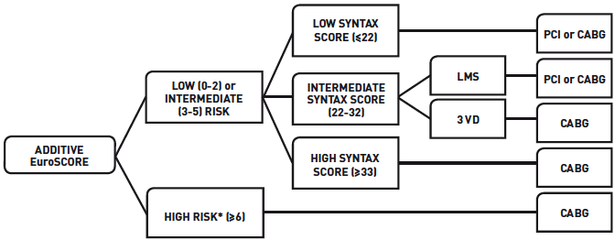

Left main coronary artery disease (old)
Figure 21
Proposed treatment algorithm for the management of LMS and 3VD incorporating clinical (additive EuroSCORE) and anatomical (SXscore) variablesReproduced with permission from Serruys et al [5, 6].
Rodrigo Modolo, Norihiro Kogame, Hidenori Komiyama, Vasim Farooq, Gregg W. Stone, Renu Virmani, Patrick W. Serruys, Alfonso Fernando
©2025 Europa Group - All rights reserved.

