Slide 1


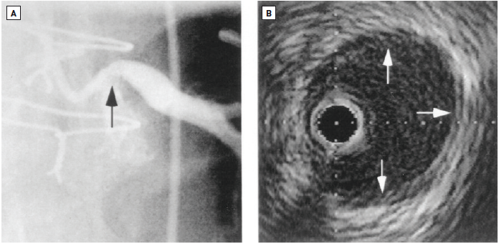

Left main coronary artery disease (old)
Figure 22
Case example illustrating the discrepancy between angiographic and IVUS evaluation of LMCA diseaseThis patient underwent bypass surgery for ostial LMCA disease (black arrow) (A). After the bypass grafts closed, he was referred for IVUS study. By QCA, the ostial LMCA stenosis MLD measured 1.32 mm. By IVUS, there was mild diffuse atherosclerosis (white arrows) (B), no significant plaque burden and an MLD of 3.5 mm. MLA was reported by 10.5 mm2. Reproduced with permission from Abizaid et al [113].
Rodrigo Modolo, Norihiro Kogame, Hidenori Komiyama, Vasim Farooq, Gregg
W. Stone, Renu Virmani, Patrick W. Serruys, Alfonso Fernando
©2025 Europa Group - All rights reserved.

