Slide 1


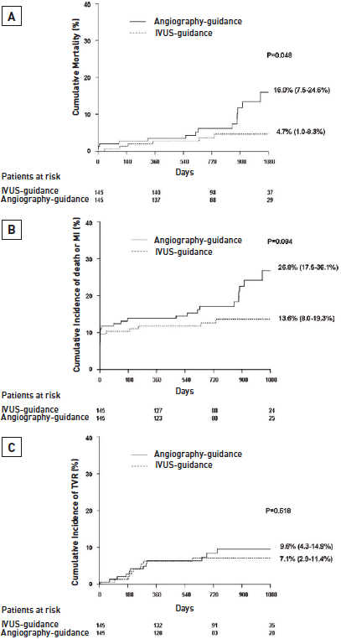

Left main coronary artery disease (old)
Figure 24
Kaplan-Meier incidence curves of long-term (3-year) clinical outcomes following IVUS and angiography guidances in 145 propensity-matched pairs of patients implanted with DES(A): three-year incidences of death.(B): three-year incidence of death or MI.(C): three-year incidence of death, MI, or TVR. Reproduced with permission from Park et al [239].
Rodrigo Modolo, Norihiro Kogame, Hidenori Komiyama, Vasim Farooq, Gregg W. Stone, Renu Virmani, Patrick W. Serruys, Alfonso Fernando
©2025 Europa Group - All rights reserved.

