Slide 1


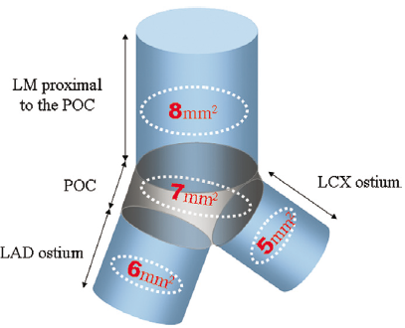

Left main coronary artery disease (old)
Figure 25
IVUS-derived minimal stent area (MSA) cut-off values for the prediction of angiographic in-stent restenosis (ISR) on a segmental basisLM: left main artery; POC: polygon of confluence; LAD: left anterior descending artery; LCX: left circumflex artery. Reproduced with permission from Kang et al [121].
Rodrigo Modolo, Norihiro Kogame, Hidenori Komiyama, Vasim Farooq, Gregg W. Stone, Renu Virmani, Patrick W. Serruys, Alfonso Fernando
©2025 Europa Group - All rights reserved.

