Slide 1


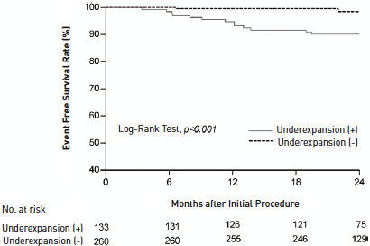

Left main coronary artery disease (old)
Figure 26
Kaplan-Meier curve for MACE-free survival in patients with IVUS-defined stent underexpansionComparisons of patients with (+) and without (-) stent underexpansion are illustrated, indicating a greater freedom from MACE at 2 years in patients without stent underexpansion (98.1±0.9% versus 90.2±2.6%, p
Rodrigo Modolo, Norihiro Kogame, Hidenori Komiyama, Vasim Farooq, Gregg W. Stone, Renu Virmani, Patrick W. Serruys, Alfonso Fernando
©2025 Europa Group - All rights reserved.

