Slide 1


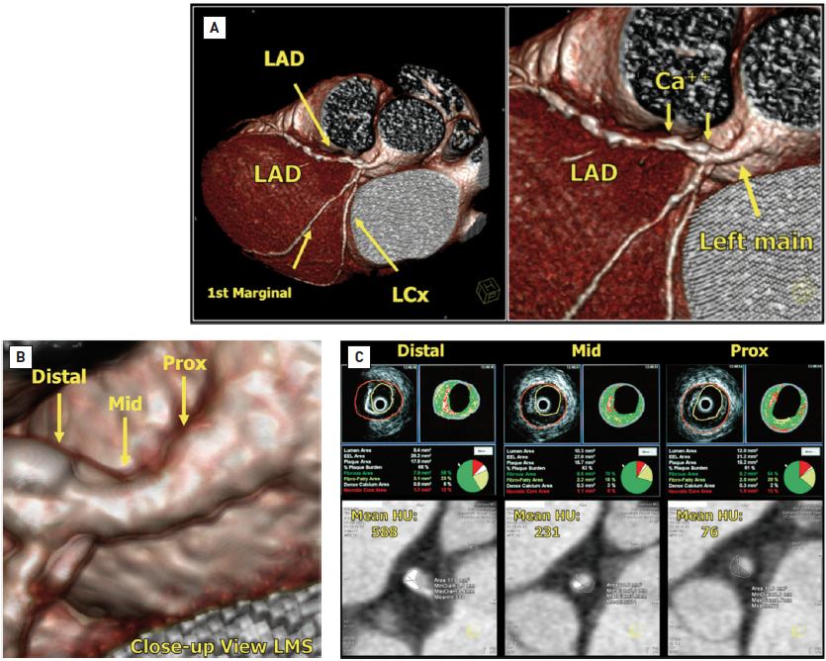

Left main coronary artery disease (old)
Figure 27
The association between quantification of calcium identified on cardiac MSCT and intravascular imaging with IVUS-VH(A): cardiac MSCT with volume rendering applied. Note the extensive area of calcification in the LMS and proximal LAD (labelled) and the diffusely diseased LAD.(B): close-up view of the LMS. Distal, mid and proximal (Prox) sections are labelled. (C): IVUS greyscale, IVUS-VH and the MSCT-derived mean Hounsfield units (HU) for the corresponding LMS sections. The lumen area throughout the LMS was >6 mm2, indicating that the LMS was not haemodynamically compromised on MSCT and IVUS greyscale. Note the decreasing area of calcification on the IVUS-VH from the distal to the proximal LMS segments, and the corresponding decrease in calcium on MSCT – as assessed by the MSCT-derived HU – despite the “blooming effect” of the calcium on MSCT, in keeping with previous reports of a good correlation with calcium quantification on MSCT and IVUS-VH [128].
Rodrigo Modolo, Norihiro Kogame, Hidenori Komiyama, Vasim Farooq, Gregg
W. Stone, Renu Virmani, Patrick W. Serruys, Alfonso Fernando
©2025 Europa Group - All rights reserved.

