Slide 1


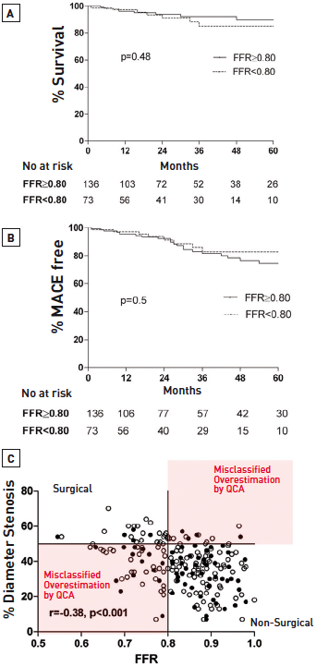

Left main coronary artery disease (old)
Figure 28
The relationship between QCA, FFR and long-term clinical outcomes in patients with an angiographically equivocal LMS stenosisFive-year survival (A) and incidence of MACE (B) were comparable in patients with a LMS FFR ≥0.80 (treated medically or when another stenosis was treated by PCI) and LMS FFR
Rodrigo Modolo, Norihiro Kogame, Hidenori Komiyama, Vasim Farooq, Gregg W. Stone, Renu Virmani, Patrick W. Serruys, Alfonso Fernando
©2025 Europa Group - All rights reserved.

