Slide 1


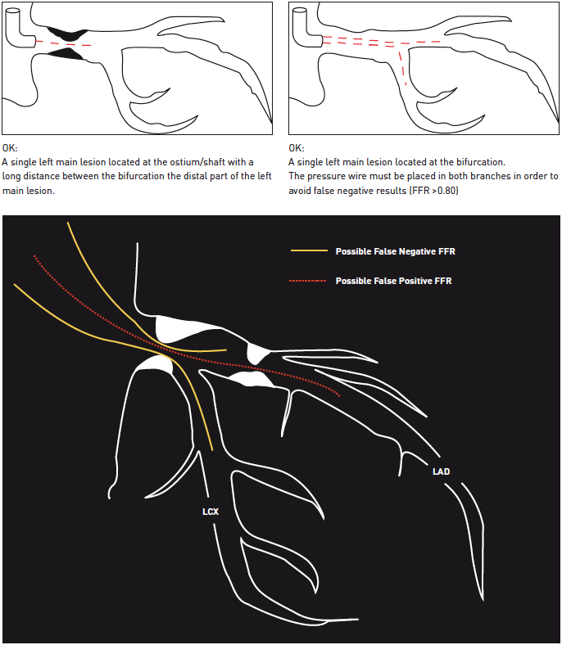

Left main coronary artery disease (old)
Figure 29
The principles of performing pressure wire assessment of LMS disease, involving positioning of the pressure wire transducerDecannulation of the guide catheter from the left main ostium is required during pressure wire assessment to prevent damping of the pressure. Further intravascular imaging may be required in the lower scenarios, such as with IVUS as previously described. Used with kind permission from the EXCEL trial investigators.
Rodrigo Modolo, Norihiro Kogame, Hidenori Komiyama, Vasim Farooq, Gregg W. Stone, Renu Virmani, Patrick W. Serruys, Alfonso Fernando
©2025 Europa Group - All rights reserved.

