Slide 1


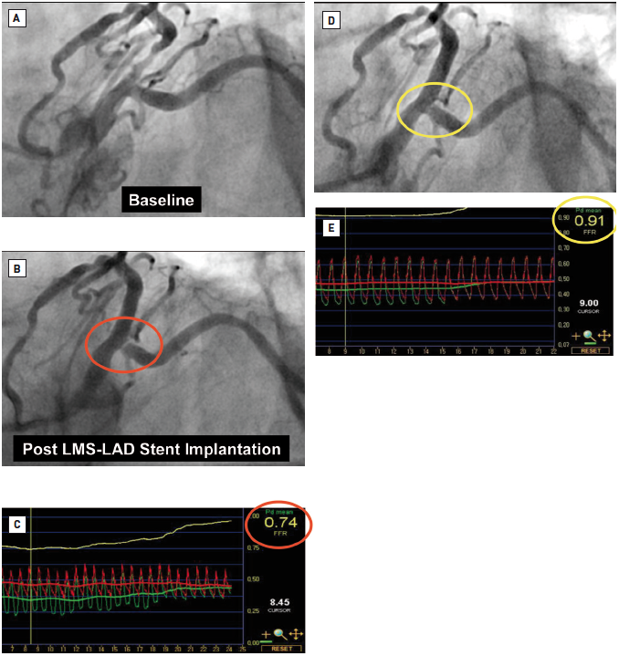

Left main coronary artery disease (old)
Figure 31
Scenario 2: provisional T-stenting approach of cross-over LMS-LAD stent implantationBaseline images (A), followed by cross-over LMS-LAD stent implantation, led to angiographic pinching of the LCx ostium which looked angiographically significant (B). In this case, functional assessment with FFR suggested haemodynamic compromise (FFR: 0.74) (C). Subsequent KBPD led to an improved angiographic appearance of the LCx ostium (D) and the near normalisation of the FFR in the LCx (0.91) (E). Courtesy of Dr. Chang Wook Nam, Kyeimyung University Hospital, South Korea.
Rodrigo Modolo, Norihiro Kogame, Hidenori Komiyama, Vasim Farooq, Gregg
W. Stone, Renu Virmani, Patrick W. Serruys, Alfonso Fernando
©2025 Europa Group - All rights reserved.

