Slide 1


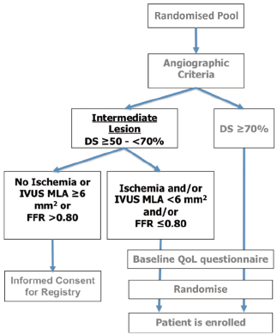

Left main coronary artery disease (old)
Figure 33
Treatment algorithm for implementing the use of coronary angiography and intravascular imaging/adjunctive devices from the on-going EXCEL trialAlthough not mandated in the EXCEL trial and as previously discussed, if the left main lesion has a MLA
Rodrigo Modolo, Norihiro Kogame, Hidenori Komiyama, Vasim Farooq, Gregg
W. Stone, Renu Virmani, Patrick W. Serruys, Alfonso Fernando
©2025 Europa Group - All rights reserved.

