Slide 1


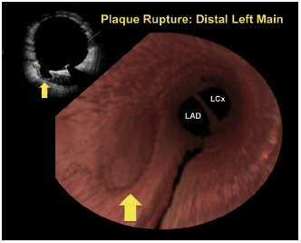

Left main coronary artery disease (old)
Figure 34
Plaque rupture in distal LMS on corresponding 2D FD-OCT frame and 3D FD-OCT reconstructionThe 3D reconstruction illustrates a fly-through view akin to the “angioscopic view”) of the LMS from proximal to distal. Note the distal bifurcation (LAD-LCx) of the LMS. Reproduced with permission from Farooq et al [136].
Rodrigo Modolo, Norihiro Kogame, Hidenori Komiyama, Vasim Farooq, Gregg W. Stone, Renu Virmani, Patrick W. Serruys, Alfonso Fernando
©2025 Europa Group - All rights reserved.

