Slide 1


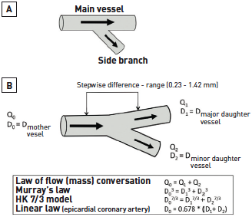

Left main coronary artery disease (old)
Figure 36
Evolution of arterial bifurcation schema(A) A conventional schema, in which the “main vessel” diameter is conserved before and after the origin of “side branch”, which is false.(B) True representation of a bifurcation, with a mother vessel dividing into two daughter vessels. Strict relations are obtained between the flow rates and diameters of the three vessels, in agreement with the law of conservation of mass (or flow). The diameter of the mother vessel is systematically greater than that of the larger daughter vessel. A fundamental fact follows from this: the greater the difference in diameter between the two daughter vessels, the greater the systematic stepwise difference between the diameters of the mother and major daughter vessels. N.B. Linear law refers to Finet’s law. Legend and figure adapted and reproduced with permission from Finet et al [182].
Rodrigo Modolo, Norihiro Kogame, Hidenori Komiyama, Vasim Farooq, Gregg
W. Stone, Renu Virmani, Patrick W. Serruys, Alfonso Fernando
©2025 Europa Group - All rights reserved.

