Slide 1


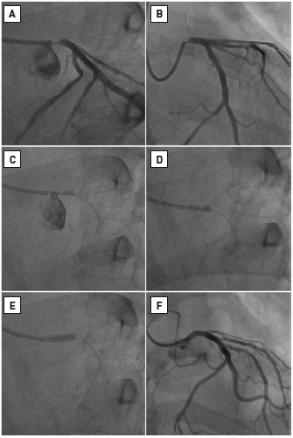

Left main coronary artery disease (old)
Figure 37
Stenting of isolated aorto-ostial left main stenosis(A)-(B) Initial appearances. (C) Positioning stent with guide catheter disengaged. (D) Stent deployment with proximal stent protruding into aorta. (E) High pressure post-dilatation. (F) Final angiographic appearance. Reproduced with permission from Fajadet et al [233].
Rodrigo Modolo, Norihiro Kogame, Hidenori Komiyama, Vasim Farooq, Gregg W. Stone, Renu Virmani, Patrick W. Serruys, Alfonso Fernando
©2025 Europa Group - All rights reserved.

