Slide 1


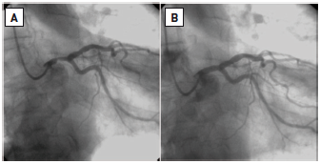

Left main coronary artery disease (old)
Figure 38
Direct stenting of isolated mid-shaft LMS stenosis(A) Baseline coronary angiography: short, non-calcified lesion of mid LMS treated by direct stenting. (B) Final angiographic appearance. Reproduced with permission from Fajadet et al [233].
Rodrigo Modolo, Norihiro Kogame, Hidenori Komiyama, Vasim Farooq, Gregg W. Stone, Renu Virmani, Patrick W. Serruys, Alfonso Fernando
©2025 Europa Group - All rights reserved.

