Slide 1


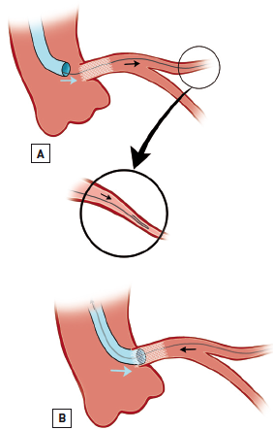

Left main coronary artery disease (old)
Figure 39
Guide catheter manipulation using a looped wire positioned in the coronary vessel peripheryCareful withdrawal and advancement of the looped coronary wire (A) leads to the advancement or retraction of the guide catheter, respectively (B), without any significant risk of distal perforation. Adapted from Tamburino et al [240].
Rodrigo Modolo, Norihiro Kogame, Hidenori Komiyama, Vasim Farooq, Gregg W. Stone, Renu Virmani, Patrick W. Serruys, Alfonso Fernando
©2025 Europa Group - All rights reserved.

