Slide 1


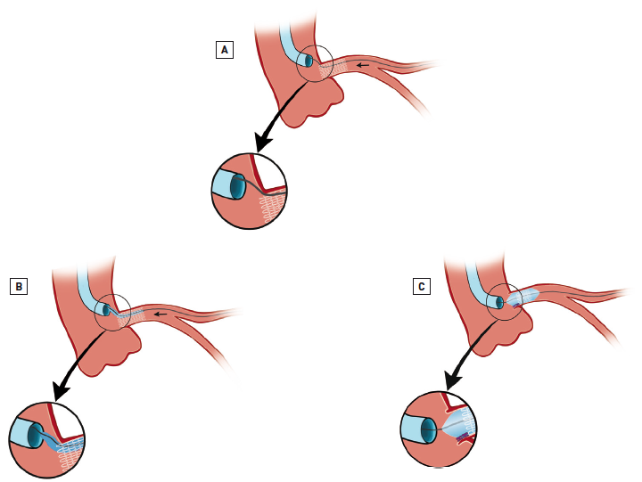

Left main coronary artery disease (old)
Figure 44
Second choice solution to cannulate the left main, particularly if emergency access is requiredIn emergency situations where it is difficult to cannulate the LMS ostium, the coronary wire can be passed into an ostial stent cell of a previously implanted LMS ostial stent (A). Subsequently, the few struts at the ostium can be crushed with a conventional angioplasty balloon to create a double layer of struts at the ostium (B-C) allowing access. Adapted from Tamburino et al [240].
Rodrigo Modolo, Norihiro Kogame, Hidenori Komiyama, Vasim Farooq, Gregg
W. Stone, Renu Virmani, Patrick W. Serruys, Alfonso Fernando
©2025 Europa Group - All rights reserved.

