Slide 1


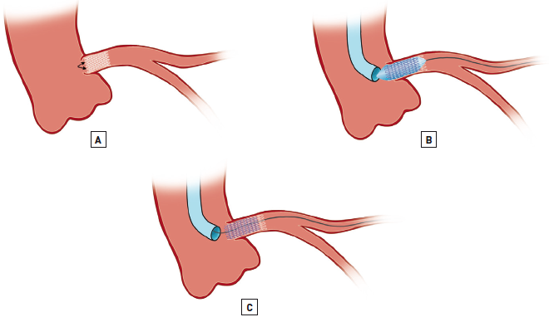

Left main coronary artery disease (old)
Figure 45
Geographical miss of LMS ostiumGeographical miss (in cases of anterograde stent shift during stent implantation) can lead to non-coverage of ostial disease (arrow, [A]). This inva-riably requires implantation of an overlapping stent (B) to cover the ostium, followed by post-dilatation with the balloon further retracted into the aortic root to flair the struts at the ostium (not illustrated).
Rodrigo Modolo, Norihiro Kogame, Hidenori Komiyama, Vasim Farooq, Gregg W. Stone, Renu Virmani, Patrick W. Serruys, Alfonso Fernando
©2025 Europa Group - All rights reserved.

