Slide 1


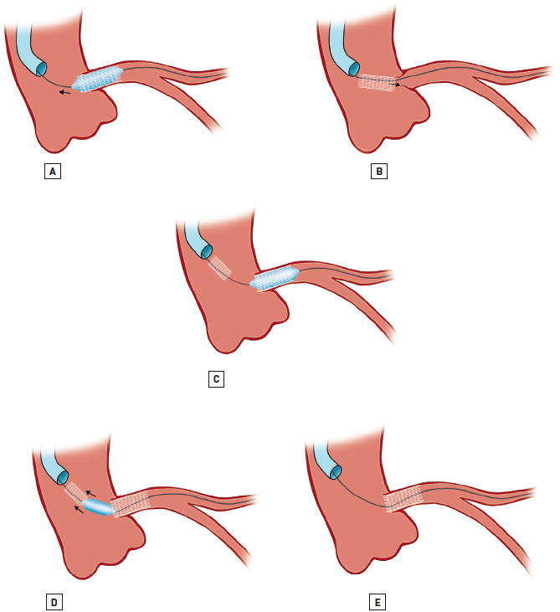

Left main coronary artery disease (old)
Figure 46
Left main stent loss into the aortic root during balloon withdrawalAfter expanding the stent (A), particularly if undersized, the balloon adheres to the stent with displacement proximally into the aortic root (B). In order to secure wire position, a second stent is deployed through the dislodged first stent (C), and the deploying balloon of the second stent reinflated to entrap the dislodged stent from the aortic root (D) with the subsequent removal of all equipment through the femoral sheath. Final result (E).Adapted from Tamburino et al [240].
Rodrigo Modolo, Norihiro Kogame, Hidenori Komiyama, Vasim Farooq, Gregg W. Stone, Renu Virmani, Patrick W. Serruys, Alfonso Fernando
©2025 Europa Group - All rights reserved.

