Slide 1


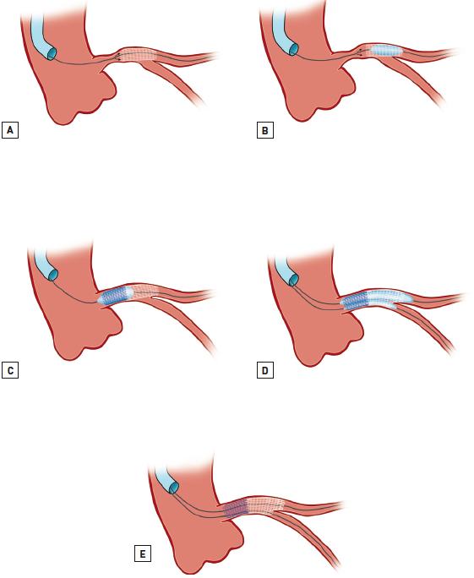

Left main coronary artery disease (old)
Figure 47
Distal stent dislodgementImmediately after stent implantation in the mid LMS, the stent became dislodged distally due to inadequate sizing (A). Treatment involves post dila-ting the dislodged stent to secure position and prevent further distal stent dislodgement (B), implantation of a more proximal overlapping stent (C) and KBPD (D) to finish (E). Adapted from Tamburino et al [240].
Rodrigo Modolo, Norihiro Kogame, Hidenori Komiyama, Vasim Farooq, Gregg W. Stone, Renu Virmani, Patrick W. Serruys, Alfonso Fernando
©2025 Europa Group - All rights reserved.

